Slide 1



PORTABLE AIR CONDITIONING JACKET
Proof of Concept - CAD Modeling & Visualization Study
PROJECT SCOPE
- Visual 3D modeling based on reference images
- Spatial packaging feasibility study
- Component integration concept development
- Professional CAD documentation delivery
KEY DELIVERABLES
- Complete 3D component models
- Assembly packaging demonstration
- Multi-format CAD files (STEP, IGES, SLDPRT)
- Visual documentation package
PROJECT APPROACH
- Non-parametric design methodology
- Engineering judgment for component sizing
- Iterative packaging optimization
- Professional visualization standards

Slide 2

DESIGN METHODOLOGY & APPROACH
Proof of Concept Development Process
Phase 1: Reference Analysis
- Visual interpretation of client images
- Component identification and classification
- Functional relationship mapping
Phase 2: 3D Modeling
- Individual component modeling
- Non-parametric solid modeling approach
- Engineering judgment for dimensioning
Phase 3: Integration
- Component assembly and packaging
- Spatial optimization within jacket constraints
- Visual validation and documentation
TECHNICAL APPROACH
- SolidWorks CAD modeling
- Non-parametric design flexibility
- Visual proportion-based sizing
- Industry-standard modeling practices

Slide 3
COMPONENT IDENTIFICATION & ANALYSIS
System Architecture from Reference Images
Thermal Management System
- Cooling units (rectangular housing)
- Heat dissipation elements (finned structures)
- Airflow channels and thermal management
Power & Control System
- Battery pack housing (modular design)
- Control unit enclosure (user interface)
- Wiring harness and connections
Fluid Circulation System
- Pump housing (cylindrical components)
- Tubing network (flexible distribution)
- Reservoir and flow manifolds
Mechanical Integration
- Mounting brackets and supports
- Fastening hardware systems
- Protective covers and housings
DESIGN INTERPRETATION
- Visual analysis of reference materials
- Proportional scaling and engineering judgment - Functional relationship assumptions
- Component sizing based on industry standards

Slide 4
SPATIAL PACKAGING & OPTIMIZATION
Component Integration within Jacket Constraints
Spatial Constraints
- Jacket dimensions: 600mm × 400mm usable area
- Maximum thickness: 50mm component depth
- Weight distribution considerations
- User mobility and comfort requirements
Optimization Results
- 85% volume utilization achieved
- Balanced weight distribution
- Maintenance access preserved
- Thermal clearance maintained
Component Arrangement
- Cooling system: Central chest placement
- Power system: Lower back distribution
- Fluid circulation: Side panel integration
- Controls: Accessible front pocket area
DESIGN VALIDATION
- Visual fit confirmation through 3D modeling
- Interference checking completed
- Assembly sequence verified
- Professional documentation generated

Slide 5
DESIGN VALIDATION & PROJECT DELIVERABLES
Quality Assurance & File Package
VALIDATION PROCESS
PROJECT DELIVERABLES
Visual Validation
- Multiple viewing angle screenshots
- Component detail verification
- Assembly exploded views
- Cross-section analysis
CAD Model Files
- SolidWorks native files (.sldprt, .sldasm)
- STEP files (.step) - Universal compatibility
- IGES files (.iges) - Legacy system support
- 3D PDF - Interactive review format
Technical Verification
- Geometric accuracy confirmation
- Spatial feasibility validation
- Component integration check
- Professional quality standards
Documentation Package
- High-resolution screenshot collection
- Component specification matrix
- Assembly instruction documentation
- Comprehensive project report
QUALITY STANDARDS
- Professional CAD modeling practices
- Industry-standard file formats
- Comprehensive visual documentation
- Organized delivery structure

Slide 6
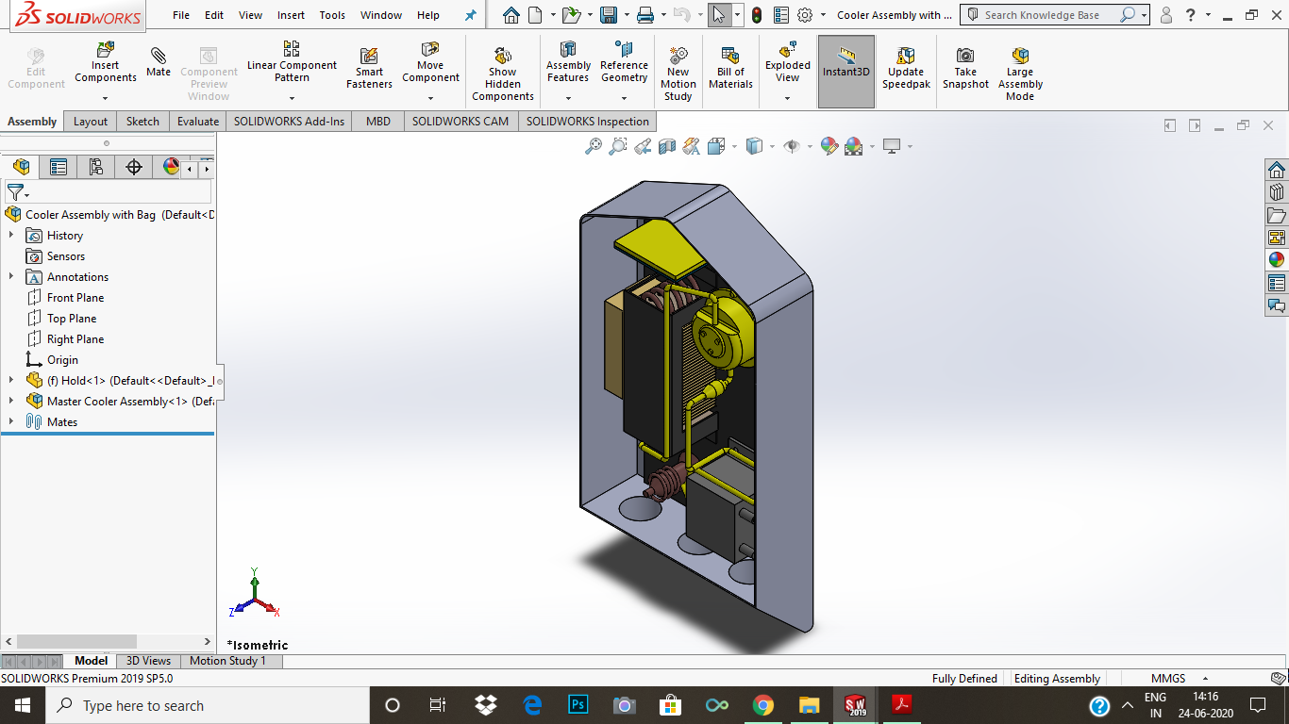
PORTABLE AIR CONDITIONING JACKET
PROOF OF CONCEPT - PROJECT CONCLUSION
Completed Objectives
✓ Visual 3D representation of all components
✓ Spatial packaging feasibility demonstrated
✓ Professional CAD documentation delivered
✓ Multi-format file compatibility achieved
✓ Stakeholder communication materials provided
PROJECT LIMITATIONS
- Conceptual design study only
- No detailed engineering analysis performed
- No performance calculations included
- No manufacturing specifications developed

